Slide 1
Hall Management System

Slide 2
Subsystem
1. Computerized Hall Seat Alocation
2. Hall Mess management System
3. Virtual Notice Board & Complain box
4. Room Maintenance System
5. Event Management System

Slide 3
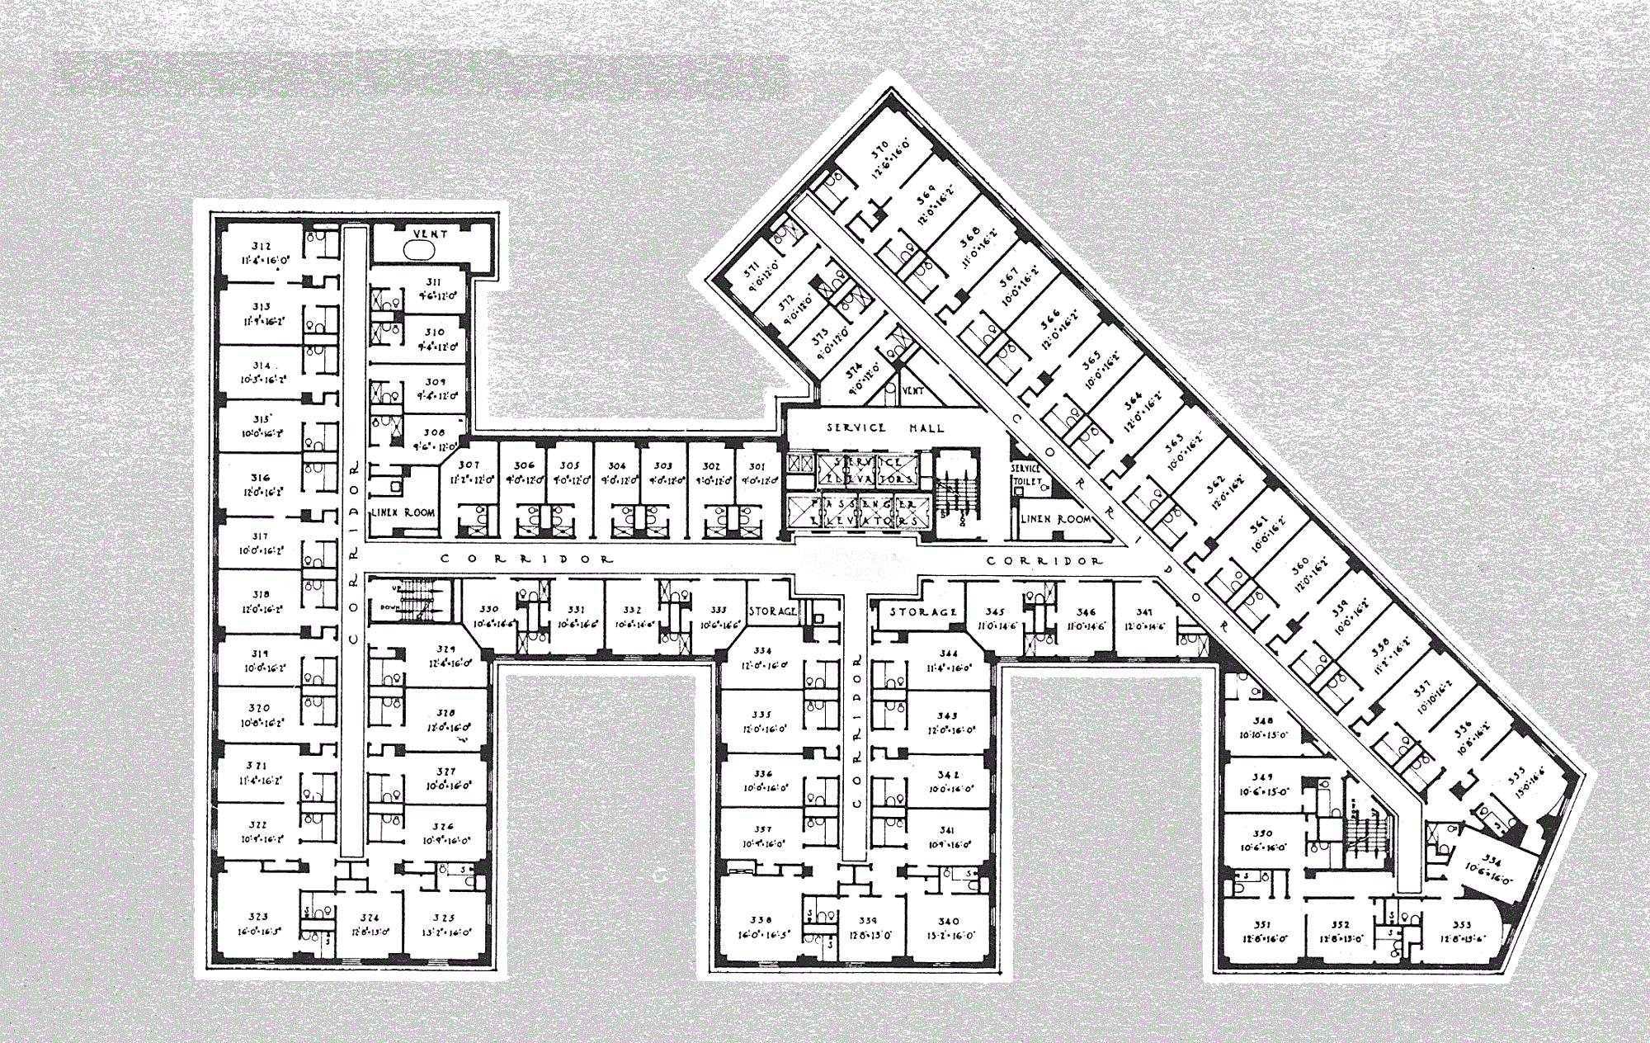
1. Computerised Hall Seat Allocation

Slide 4
1. Computerised Hall Seat Allocation
1.1 Apply For Seat
1.2 Eligibility Checking
1.3 Approval
1.4 Check for Empty Room
1.5 Seat Allocation
1.6 Inform Student
1.7 Inform Authority

Slide 5
1.Computerized Hall Seat Allocation
Use Case Diagram:
Figure 1: Use Case Diagram of Hall Seat Allocation

Slide 6
1.1 Apply For Seat
Figure : Sequence Diagram of Applying for Seat

Slide 7
1.1 Apply For Seat
Fig 1.1 : State-chart Diagram

Slide 8
1.2 Eligibility Checking
Figure : Sequence Diagram of Applying for Seat

Slide 9
1.2 Eligibility Checking
Fig 1.2 : State-chart Diagram

Slide 10
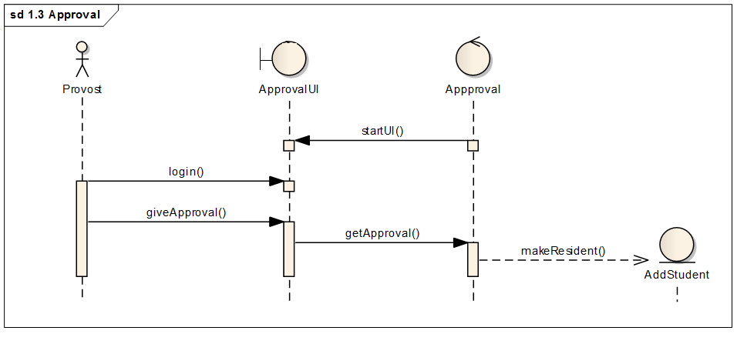
1.3 Approval
Figure : Sequence Diagram of Approval

Slide 11
1.3 Approval
Fig 1.3 : State-chart Diagram

Slide 12
1.4 Check For Empty Room
Figure: Sequnce Diagram of Checking for an Empty Room

Slide 13
1.4 Check for Empty Room
Fig 1.4 : State-chart Diagram

Slide 14
1.5 Seat Allocation
Figure: Sequence Diagram of Seat Allocation

Slide 15
1.5 Seat Allocation
Fig 1.5 : State-chart Diagram

Slide 16
1.6 Inform Student
Figure : Sequence Diagram of Informing The Student

Slide 17
1.6 Inform Student
Fig 1.6 : State-chart Diagram

Slide 18
1.7 Inform Authority
Figure : Sequence Diagram of Inform Authority

Slide 19
1.7 Inform Authority
Fig 1.7 : State-chart Diagram

Slide 20

2. Hall Mess Management System

Slide 21
2. Hall Mess Management System
2.1 Mess Manager Election
2.1.1. Apply For Mess Management
2.1.2.Check Whether Eligible
2.1.3.Voting
2.1.4. Approve and Announce
2.2 Mess Meal Selection
2.2.1 Give Menu List
2.2.2 Select and Submit within Time
2.2.3 Default Meal if not Submitted

Slide 22
2.1.Mess Manager Election
Use Case
Diagram:
Figure 2.1.Use Case Diagram of Mess Manager Election

Slide 23
2.1.1 Apply For Mess Manager
Figure : Sequence Diagram of Applying For Mess Manager

Slide 24
2.1.1 Apply For Mess Management
Fig 2.1.1 : State-chart Diagram

Slide 25
2.1.2 Check Whether Eligible
Figure : Sequence Diagram of Applicants’ Eligibility

Slide 26
2.1.2 Check if Eligible
Fig 2.1.2 : State-chart Diagram

Slide 27
2.1.3 Voting
Figure : Sequence Diagram of Voting

Slide 28
2.1.3 Voting
Fig 2.1.3 : State-chart Diagram

Slide 29
2.1.4 Approve and Announce
Figure : Sequence Diagram of Approving and Announcement

Slide 30
2.1.4 Approve and Announce
Fig 2.1.4 : State-chart Diagram

Slide 31
2. Hall Mess Management System
2.1 Mess Manager Election
2.1.1. Apply For Mess Management
2.1.2.Check Whether Eligible
2.1.3.Voting
2.1.4. Approve and Announce
2.2 Mess Meal Selection
2.2.1 Give Menu List
2.2.2 Select and Submit within Time
2.2.3 Default Meal if not Submitted

Slide 32
2.2.Mess Meal Selection
Use Case
Diagram:
Figure 2.2: Use case diagram of mess meal selection

Slide 33
2.2.1 Give Menu List
Figure : Sequence Diagram of Menu List

Slide 34
2.2.1 Give Menu List
Fig 2.2.1 : State-chart Diagram

Slide 35
2.2.2 Select and Submit Within Time
Figure : Sequence Diagram of Menu Selecting and Submitting Within Time

Slide 36
2.2.2 Select and Submit within time
Fig 2.2.2 : State-chart Diagram

Slide 37
2.2.3 Default Menu if Not Submitted
Figure : Sequence Diagram of Default Menu

Slide 38
2.2.3 Default Meal if not Selected
Fig 2.2.3 : State-chart Diagram

Slide 39
Activity Diagram

Slide 40
1. Computerised Hall Seat Allocation
1.1 Apply For Seat
1.2 Eligibility Checking
1.3 Approval
1.4 Check for Empty Room
1.5 Seat Allocation
1.6 Inform Student
1.7 After Occupying Seat Inform Authority

Slide 41
1.1 Apply For Seat
Student asks for a application form
Control sends application form to student
Student fills the application form
Application is submitted by student
Application is received by authority
Activity diagram

Slide 42
1.2 Eligibility Checking
Application status
Accepted
Provost get Application
A meeting is called
Rejected
Decision is made after the meeting
Student get notification about the meeting
Meeting is arranged
Decision is stored
Activity diagram

Slide 43
1.3 Approval
Provost give Decision
[Is eligible?]
[Yes]
Student is made resident
[No]
Activity Diagram

Slide 44
1.4 Check For empty Room
Supervisor Checks for empty room
[If available?]
Supervisor Prepare a list of empty room no
[Yes]
[No]
Activity Diagram

Slide 45
1.5 Seat Allocation
Supervisor asks for selected room from the control class
Control sends the selected room no
Room is allocated for the students
Activity Diagram

Slide 46
1.6 Inform student
Supervisor set notification
Notification is sent to student
Student gets Notification
Activity Diagram

Slide 47
1.7 Inform Authority
Student set notification
Notification is sent to authority
Authority gets Notification
Activity Diagram

Slide 48
2. Hall Mess Management System
2.1 Mess Manager Election
2.1.1. Apply For Mess Management
2.1.2.Check Whether Eligible
2.1.3.Voting
2.1.4. Approve and Announce
2.2 Mess Meal Selection
2.2.1 Give Menu List
2.2.2 Select and Submit within Time
2.2.3 Default Meal if not Submitted

Slide 49
2.1.1 Apply for mess management
Students get Application form
Fill the application form
Application is received by Authority
Submit the application
Activity Diagram

Slide 50
2.1.2 Check whether eligible
Provosts get application from control class
Applicant is notified
Provosts make decision
[Is Eligible?]
Applicant is selected
[No]
[Yes]
Activity Diagram

Slide 51
2.1.3 Voting
Students ask for candidate list from control class
Control class supplies candidate list
Vote is counted
Students vote
Activity diagram

Slide 52
2.2.4 Approve and Announce
Provost gets the result from control class
Students get notified
Provost gives approval
[Is approved?]
Result is announced
[Yes]
[No]
Activity Diagram

Slide 53
2.2.1 Give Menu List
Mess manager asks control to show menu form
Control class shows the menu form
Mess manager fill the menu form
Menu list is updated
Activity Diagram

Slide 54
2.2.2 Select and Submit Menu Within Time
Students ask control to show menu list
Control sends menu list to students
Students select menu
Selected menu list is updated
Activity Diagram

Slide 55
2.2.3 Default meal if not submitted
Time is checked
[If time has passed?]
Select menu from menu list
NO
Yes
Select Default Menu
Activity Diagram

